Slide 1
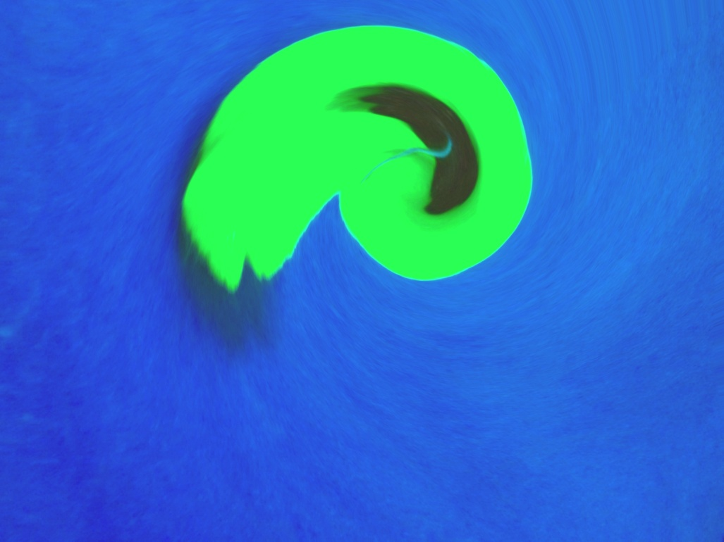
Introduction to Image Editing & Image Alteration

Slide 2
Learning Intentions
To introduce image editing and image altering
To learn about different programs, websites, and software for editing and altering digital images
To explore image editing tools
Alter an image to alter it’s meaning

Slide 3
What is image editing?

Slide 4
Image Editing
To Edit:
is to change something after to make it better
you edit after you write a story or paragraph
Image editing is changing a digital photograph using computer software.
RARELY is a photo published without retouching
many careers connected to this

Slide 5
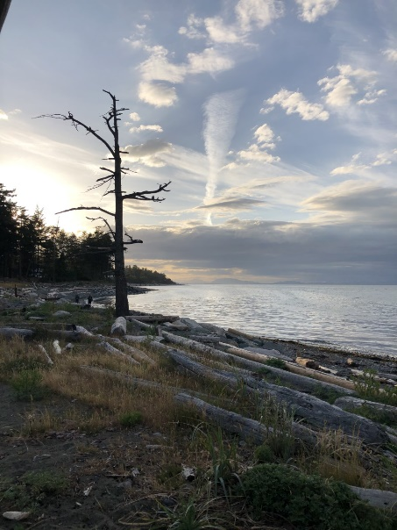
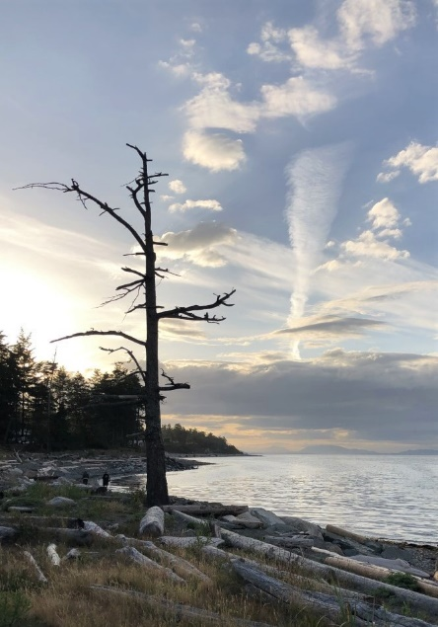
Example: cropping to focal point
Original photo at top right
Tree is subject but is too far away
Black triangle in top left corner
Photo at bottom right edited in Microsoft Photo Gallery
Image cropped to focus on tree
Colour saturated (slightly)
Photo lightened (slightly)

Slide 6
Other things to improve AFTER you take the photo:
Red eye
Rotate if crooked
Exposure (lightness/darkness)
Contrast
Sharpen
Resize
Compress

Slide 7
If you do nothing else…
…saturate the colour by 20
(Advice from many professional photographers)

Slide 8
Image editing on a computer:
Free apps or programs on most PCs – free with Microsoft Office
Simple editing program
Good for retouching photographs
Can do some artistic changes too
Demo…

Slide 9
What does it mean to alter an image?

Slide 10
To Alter:
To change
To modify
To rearrange
To alter a photo means to change the message, your message, that the image is communicating to others…
More artistic because it’s image creation

Slide 11
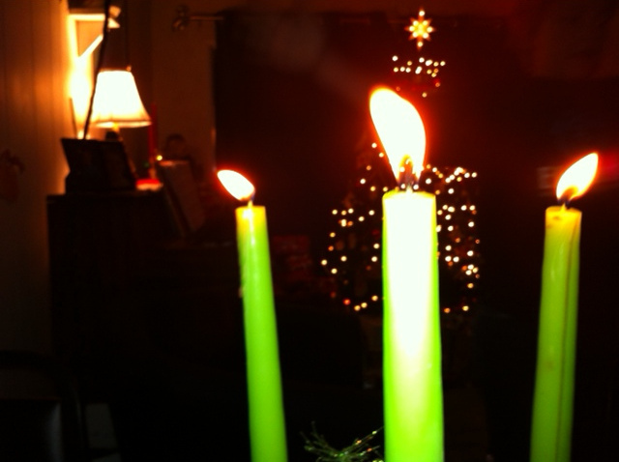
Altered to emphasize…

Slide 12
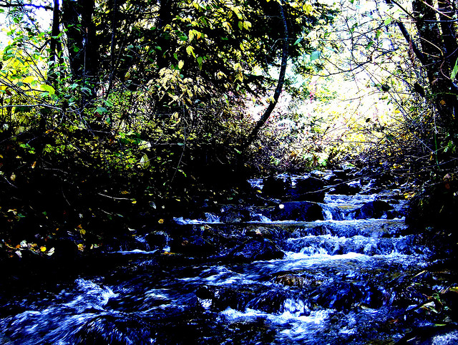
Adjust colour saturation to change the effect…

Slide 13
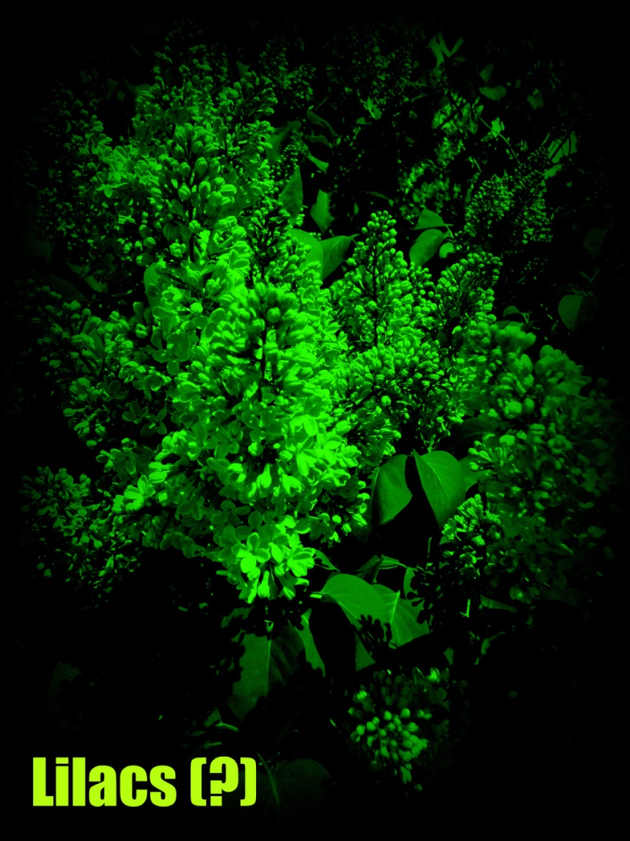
Change colour scheme (lilacs are usually purple)

Slide 14
The only limits to altering a photo are: - your imagination - the tools you use

Slide 15
Online Sites
Many Free Online Photo Editors
Most have basics for free, cool stuff sometimes costs $
Most are for users aged 13 years and up
Read terms and conditions of use - many can take, use and/or sell your photos once you upload
Pixlr, Canva, Free Online Photo Editor, Big Huge Labs, BeFunky, etc.

Slide 16
Photo Apps
Thousands of smartphone apps
Often similar to online sites
Quick and convenient – combines the camera with tools
Popular in today’s world of photography
Read terms and conditions – only trust good companies as many save/keep your photos

Slide 17
Image Editing Software
Big $
One example is Adobe Photoshop
Industry standard
Often very complex and can take time to ‘learn’
Usually available in secondary schools, sometimes for intermediate level

Slide 18
References
Stream photo:
Richard Keir (Shino_Bi- flickr.com)
Other photos taken by E. Gregory

